Slide 1
Probabilistic Slope Stability Analysis with the
“Response Surface Methodology”
(Henry T. Chiwaye)

Slide 2
Scope of Presentation
Overview of Response Surface Methodology (RSM)
Implementation of RSM in probabilistic slope stability analysis
Verification Examples
General guidelines for use of RSM

Slide 3
Slope Design Approaches
Deterministic
Factor of Safety (FOS)
Probabilistic
Risk Analysis
Probability of Failure(POF)
Economic / Safety impact
Uncertainty:
Geology
Strength
Water

Slide 4
Probabilistic Analysis
Monte Carlo Simulation
Point Estimate Method (PEM)

Slide 5
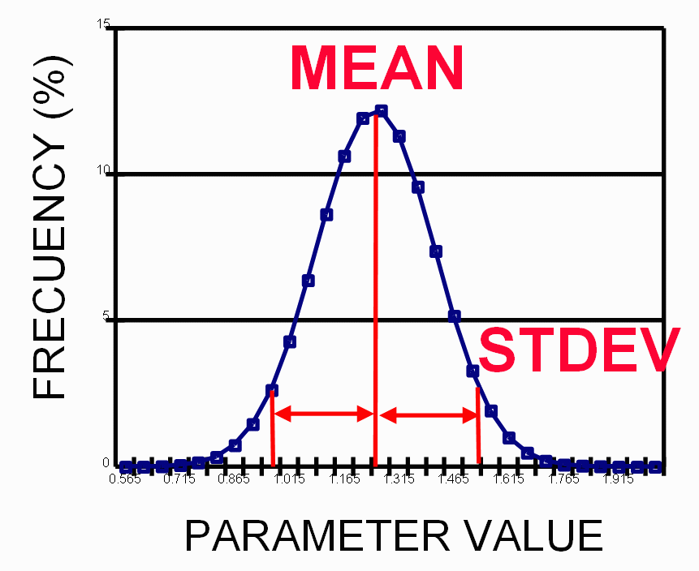
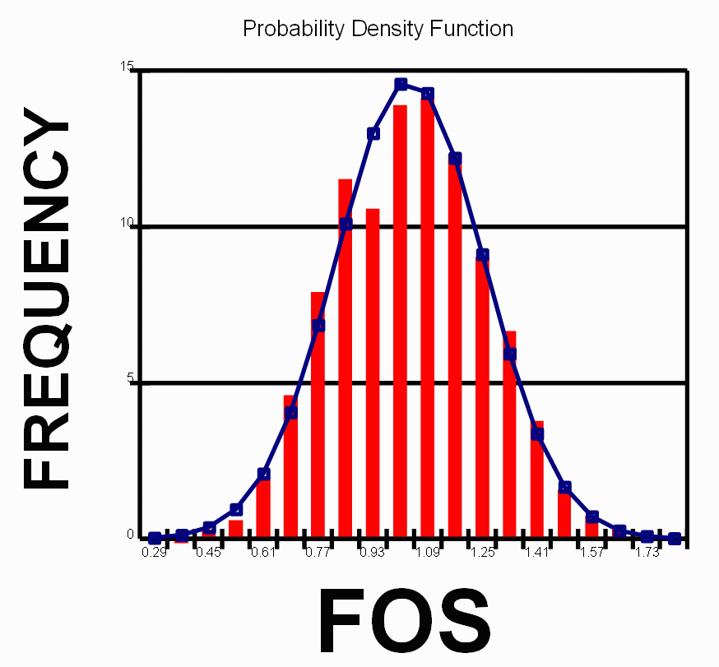
Monte Carlo Simulation
INPUT DATA
MONTE CARLO ANALYSIS
OUTPUT RESULTS
Model
1.0
Frequency
Frequency
(SLIDE, Phase2, FLAC, UDEC )
Frequency
Cohesion
Friction angle
CC
POF
FOS
POF _{model} = P ( FOS < 1.00 )
Highlights
Large no. of runs (10³).
Reveals Sensitivities
Very Flexible

Slide 6
Point Estimate Method (PEM)
INPUT DATA
2^{n} MODEL RUNS
OUTPUT RESULTS
Model
FOS Statistics
Frequency
Frequency
(SLIDE, Phase2, FLAC, UDEC )
Mean
Variance
POF
Cohesion
Friction angle
CC
Highlights
Evaluate model at 2^{n} points.
Assume a form for the FOS probability distribution
No sensitivity information

Slide 7
Response Surface Methodology
Response Surface Techniques
Monte Carlo Simulation
Probability Of Failure (%)

Slide 8
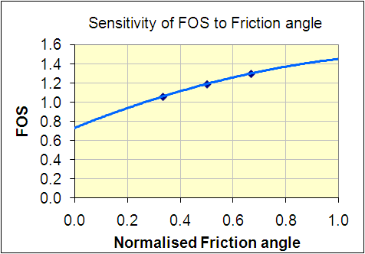
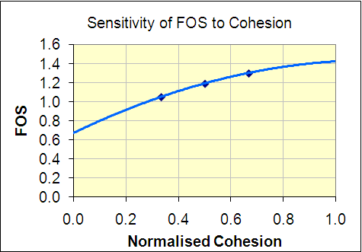
Response Surface Techniques

Slide 9
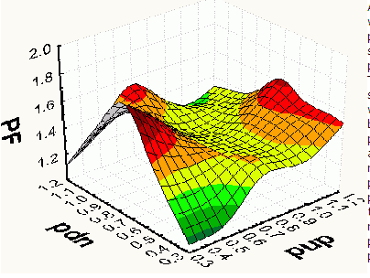
Response Surface Techniques
Concept
Evaluate model at selected points
Use interpolation scheme to generate response surface
FOS
Var 1
Var 2

Slide 10
RSM Overview
Response Surface Generation
MONTE CARLO ANALYSIS
OUTPUT RESULTS
1.0
Model (SLIDE, UDEC etc)
EXCEL
Frequency
POF
FOS

Slide 11
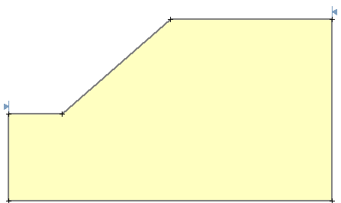
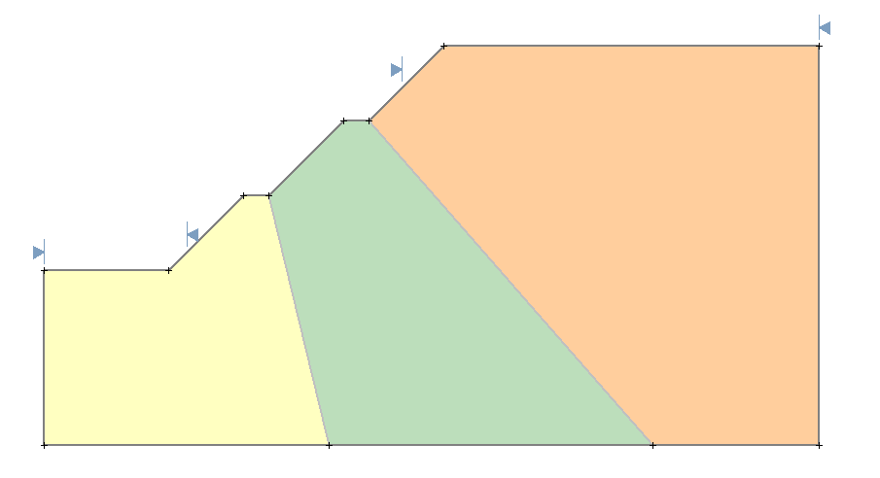
RSM Verification
Approach
RSM vs. Model (SLIDE)
Cohesion & friction angle uncertain variables
RSM using linear interpolation
Models
90m

Slide 12
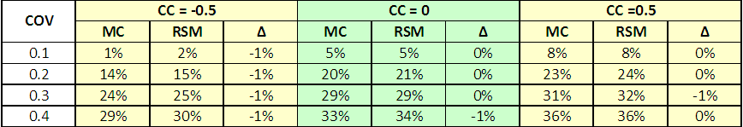


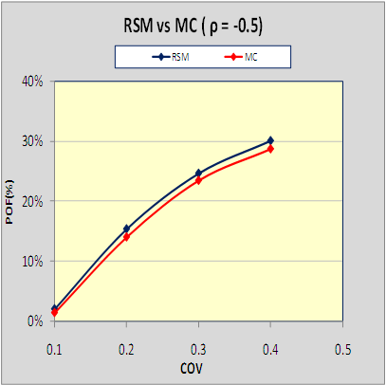
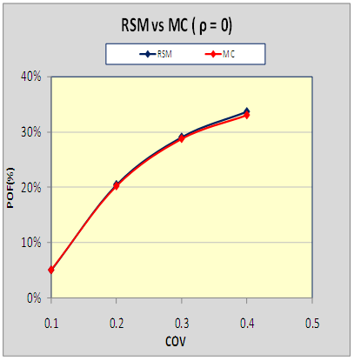
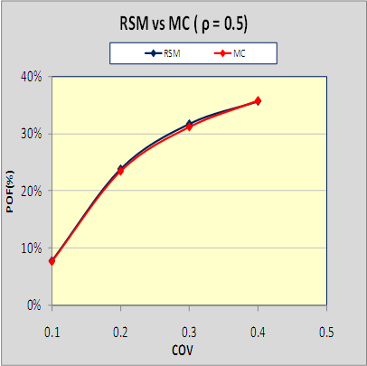
Model vs. RSM (POF %)
Homogeneous Slope: (Normal)

Slide 13
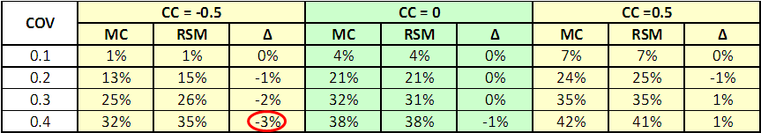
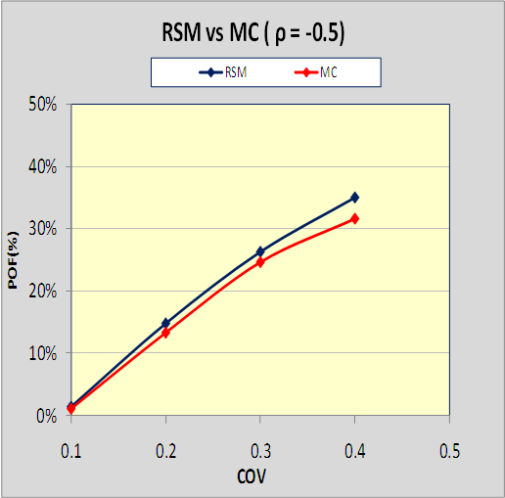
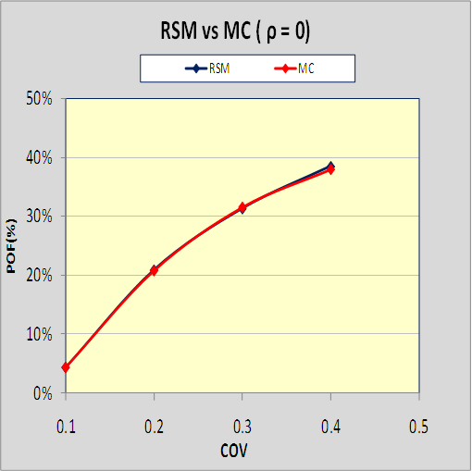
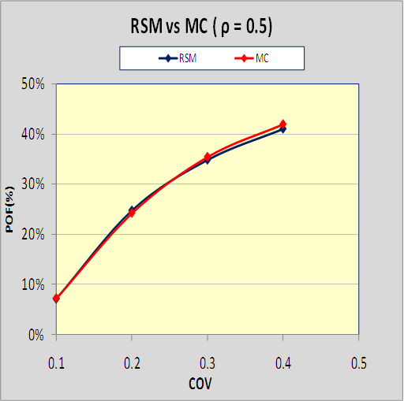
Model vs. RSM (POF %)
Homogeneous Slope : (Lognormal)

Slide 14
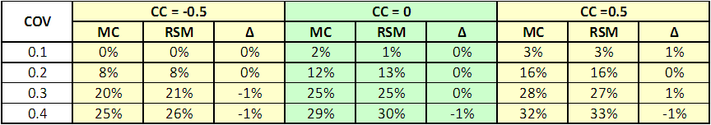
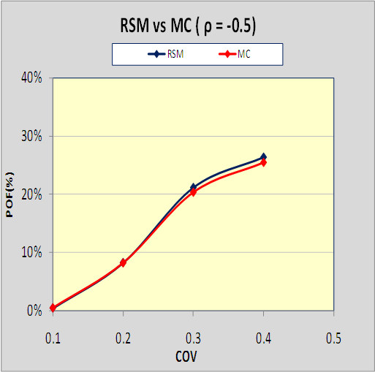
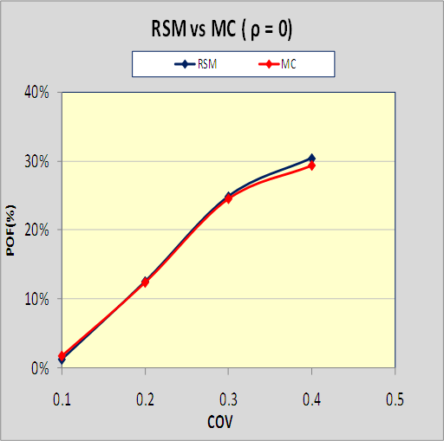
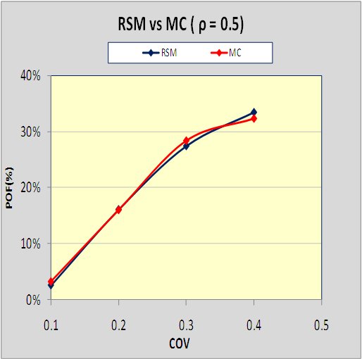
Model vs. RSM (POF %)
3 Material Slope : (Normal)

Slide 15
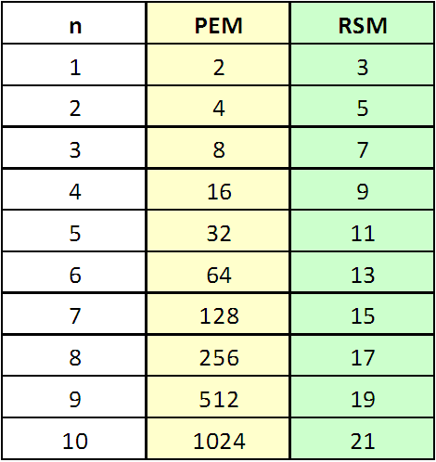
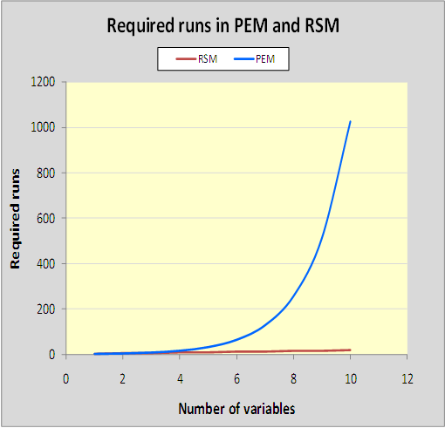
RSM vs. PEM (POF %)
Requires 2n + 1 points vs. 2^{n} for PEM

Slide 16
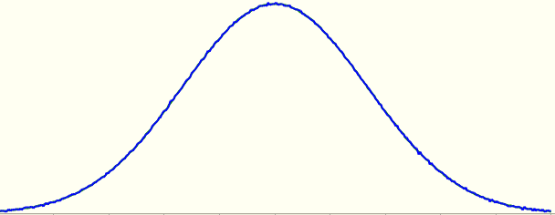
RSM Guidelines
Piecewise Linear / Quadratic interpolation can be used.
Grouping Variables
Strength
Cohesion
Friction
Angle
Evaluation points must be in region of interest (+ / - 1 std dev).

Slide 17
Remarks
Use of RSM with strongly correlated variables

Slide 18
Conclusions
Good agreement between RSM and Monte Carlo Simulation
Low computational times
Practical way to incorporate numerical analysis in probabilistic slope design
Reveals Sensitivities
Very flexible

Slide 19
Questions?

